Slide 1


Slide 2


Slide 3
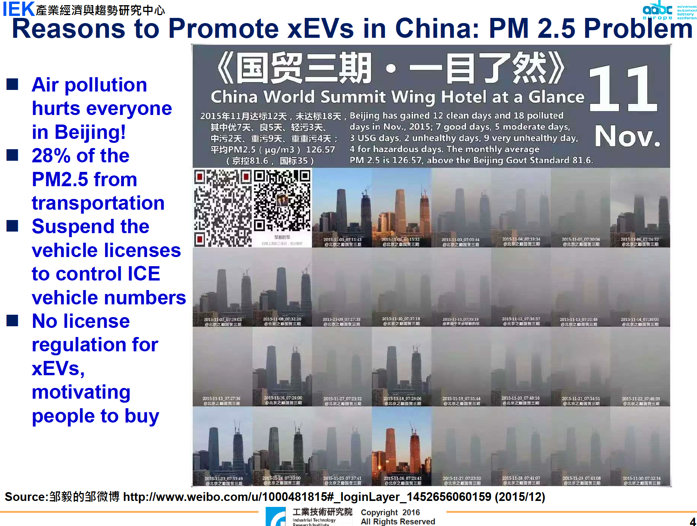

Slide 4


Slide 5

We know that technology based on the use of highly polluting fossil fuels – especially coal, but also oil and, to a lesser degree, gas – needs to be progressively replaced without delay. Until greater progress is made in developing widely accessible sources of renewable energy, it is legitimate to choose the less harmful alternative or to find short-term solutions.

Slide 6
Here are some facts that everyone should understand, but remarkably few do
Very elementary thermodynamics: There is no free energy. Energy can neither be created nor destroyed, merely converted from one type to another. All energy conversions involve some amount of waste and eventually all energy becomes heat.
Most energy globally is used for transport, heating, cooling, and making stuff (industry). Those four dwarf everything else.
Electricity must be generated at the exact instant it's used, kept in a precise balance for every second of every day. Storage is difficult and lossy (see first bullet)

Slide 7

DECOUPLE GENERATION FROM CONSUMPTION!

Slide 8
Smart Cities, No Energy Storage?
You Must Be Kidding!

Slide 9
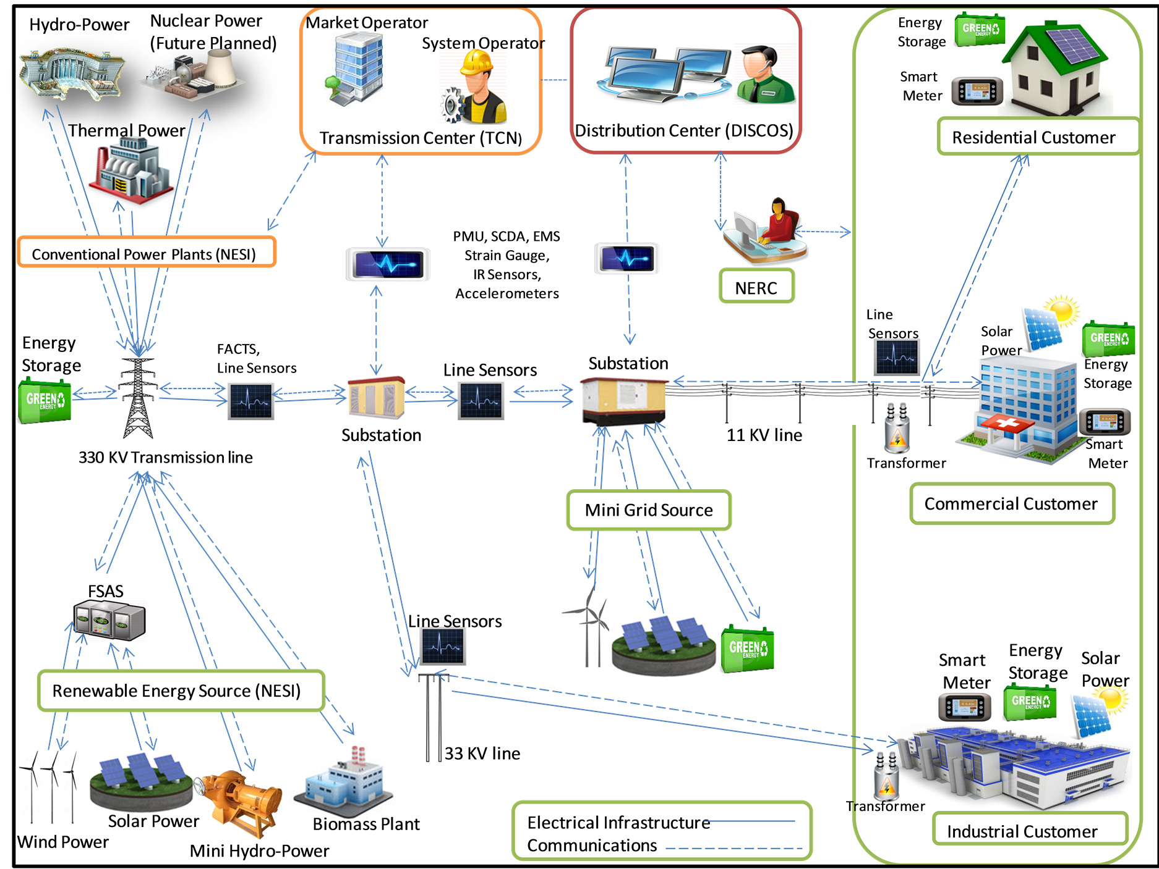

Slide 10
SMART GRID
Гибкость. Сеть должна подстраиваться под нужды потребителей электроэнергии.
Доступность. Сеть должна быть доступна для новых пользователей. В равной степени как для потребителей так и генераторов.
Надёжность. Сеть должна гарантировать защищённость и качество поставки электроэнергии.
Экономичность. Наибольшую ценность должны представлять генерирующие источники с нулевым или пониженным выбросом CO2.

Slide 11


Slide 12
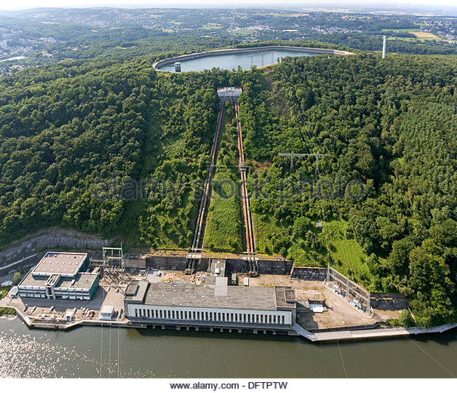

Slide 13

Energy density comparison
 | Energy density, Wh/kg
Gasoline | 12,800
Diesel | 12,000
Coal | 6,500
Gas | 10,000 (Wh/cubic meter)
Ethanol | 8,300
Methanol | 6,300
Lithium batteries | 300

Slide 14
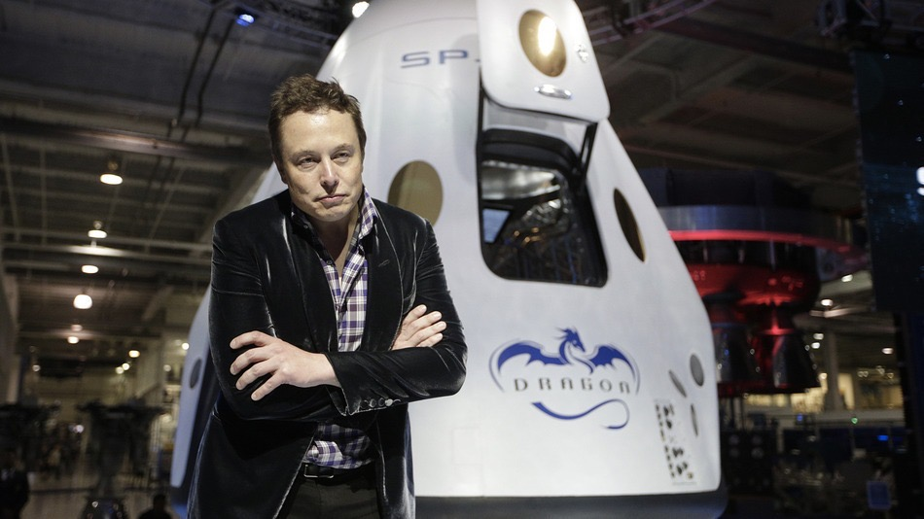
The issue with existing batteries is that they suck.
They're stinky, ugly, bad in every way

Slide 15
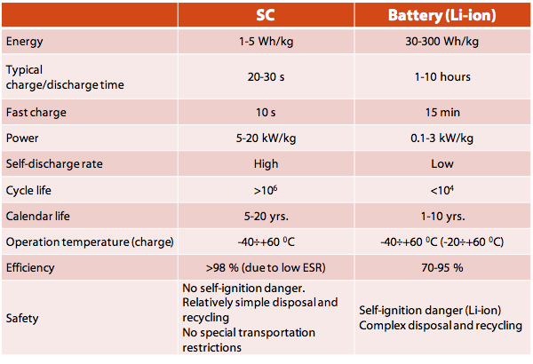

Slide 16
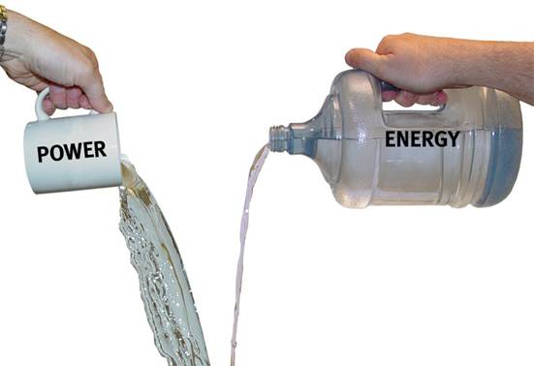

Slide 17
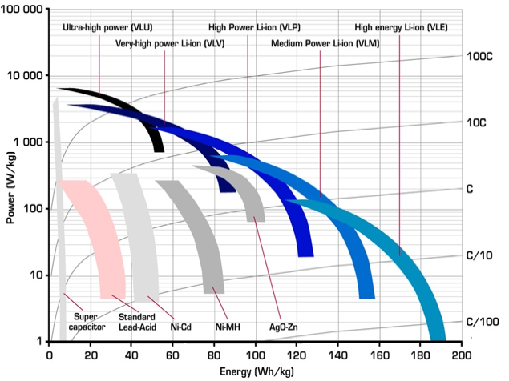

Slide 18
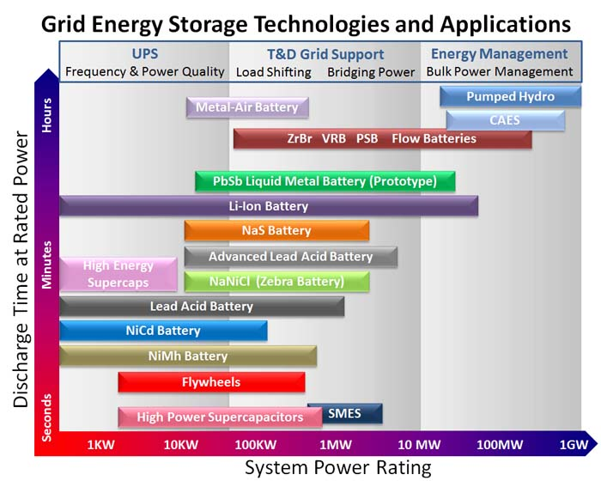

Slide 19
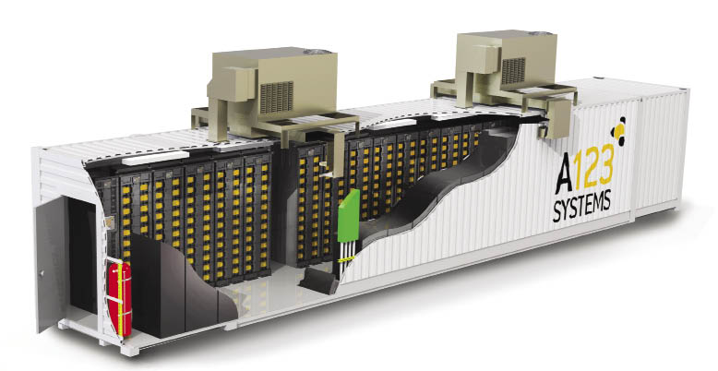
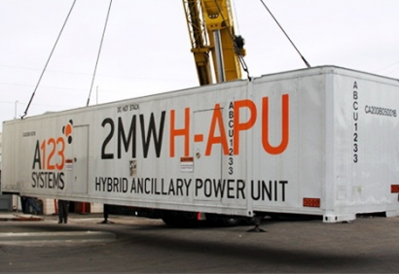
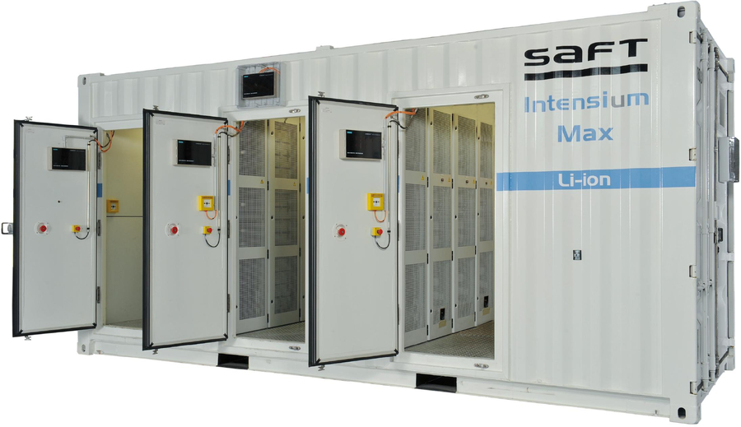
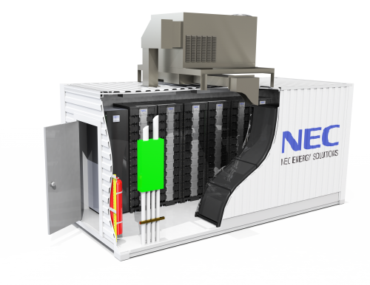

Slide 20
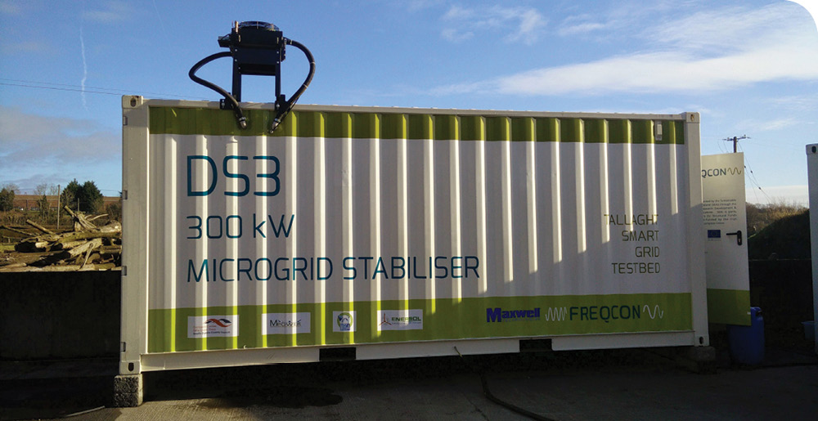

Slide 21
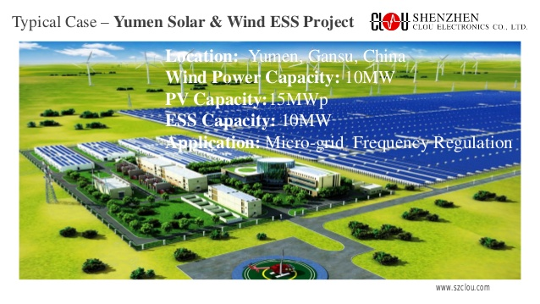

Slide 22
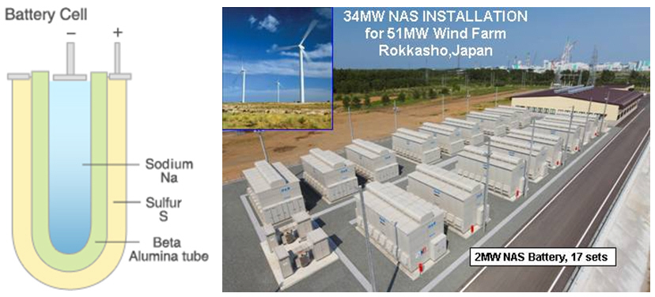

Slide 23

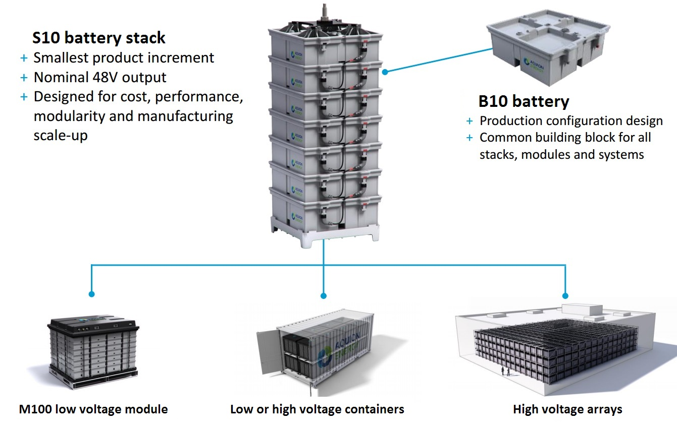

Slide 24
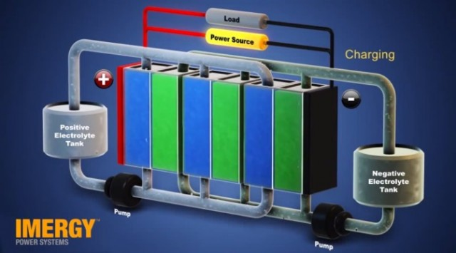
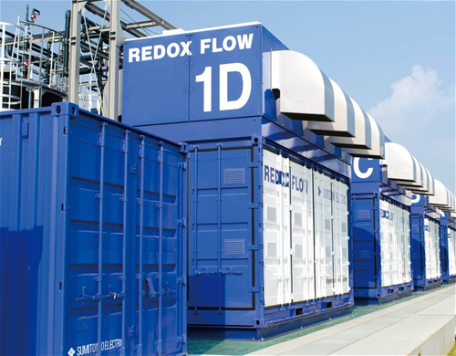
Flow Battery

Slide 25
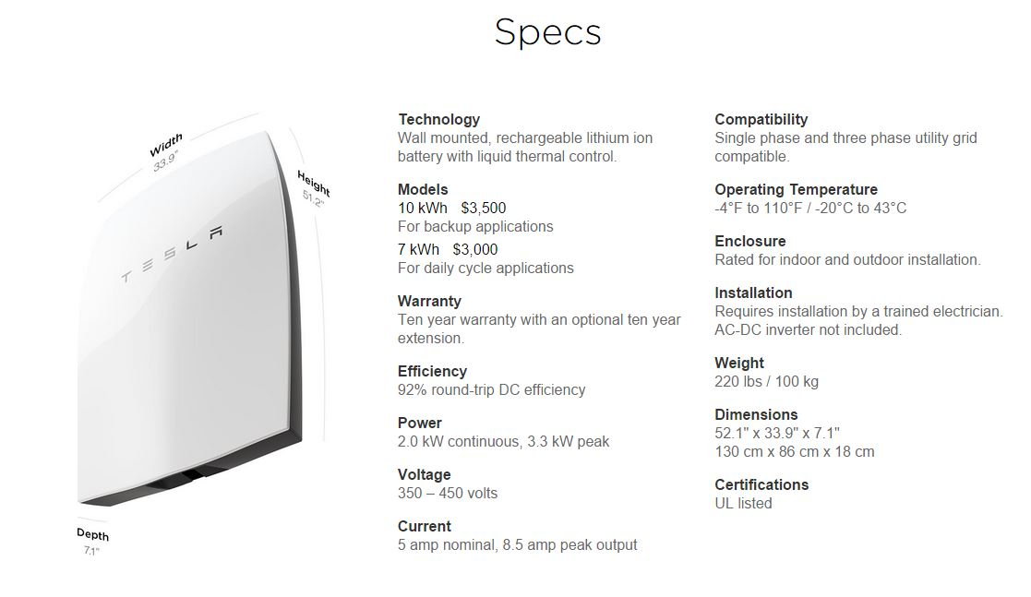

Slide 26
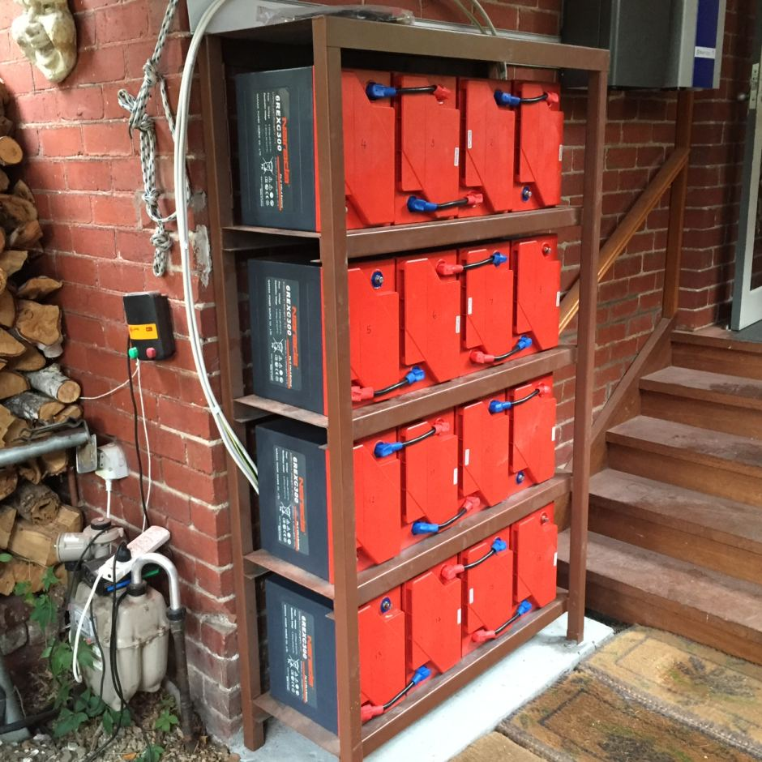

Slide 27
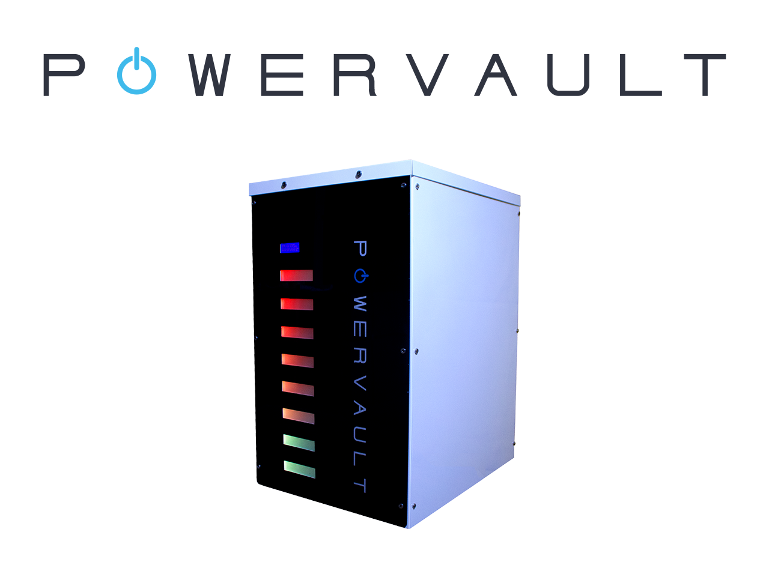
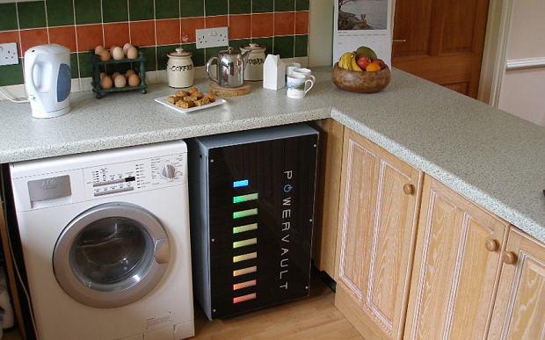

Slide 28
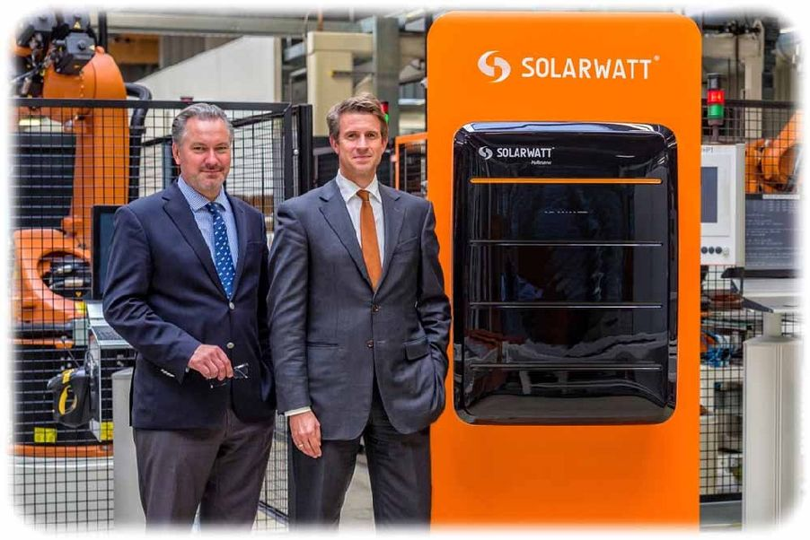

Slide 29
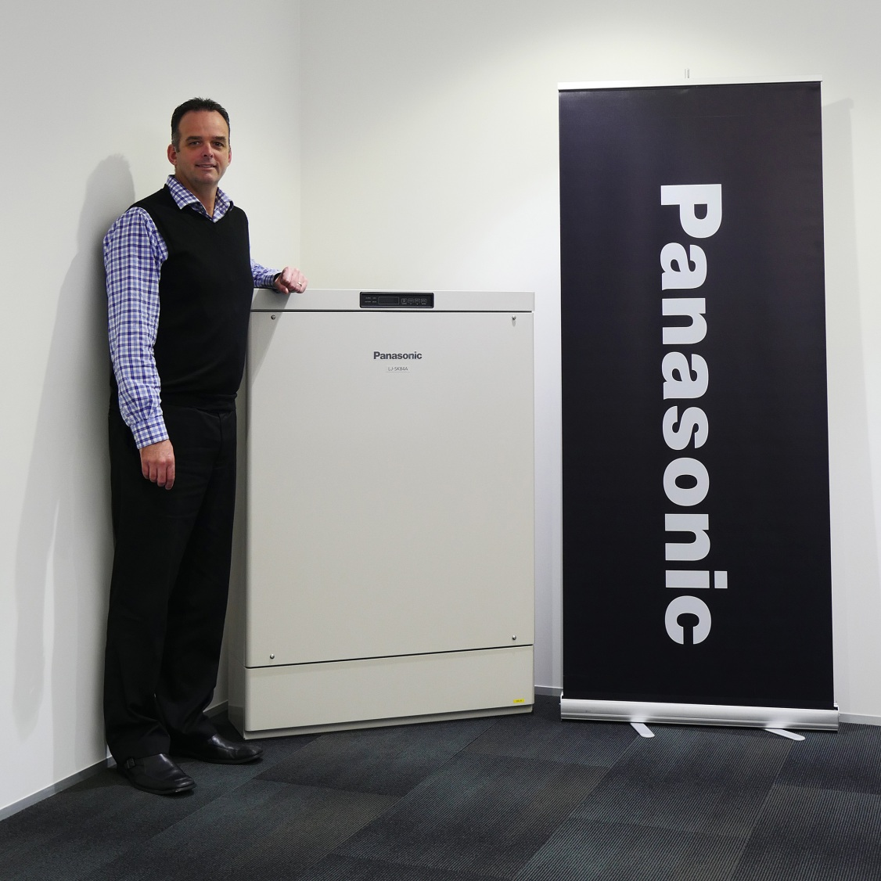


Slide 30
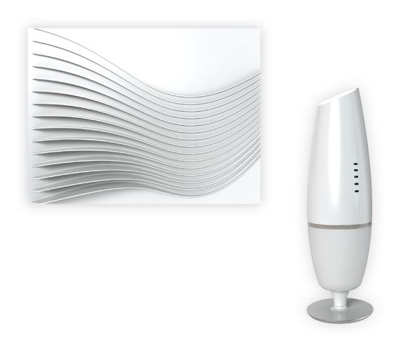


Slide 31
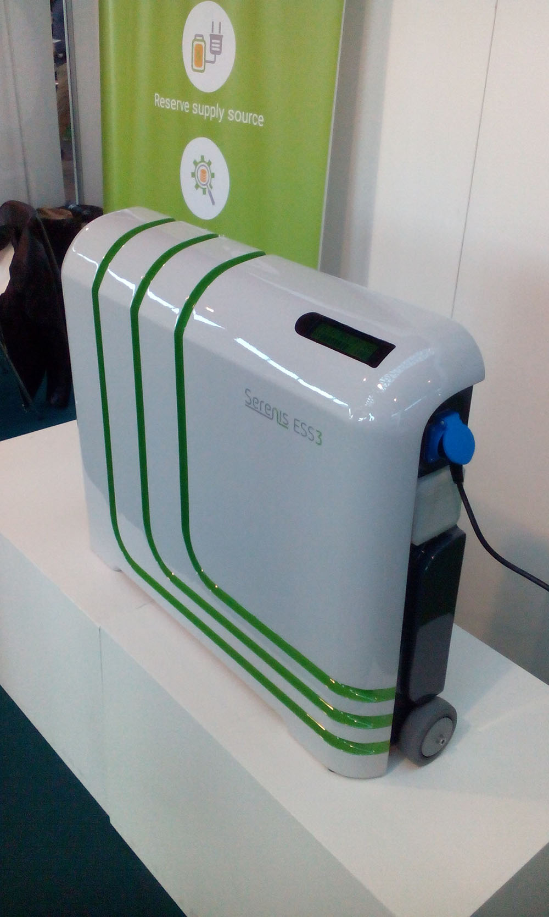

Slide 32
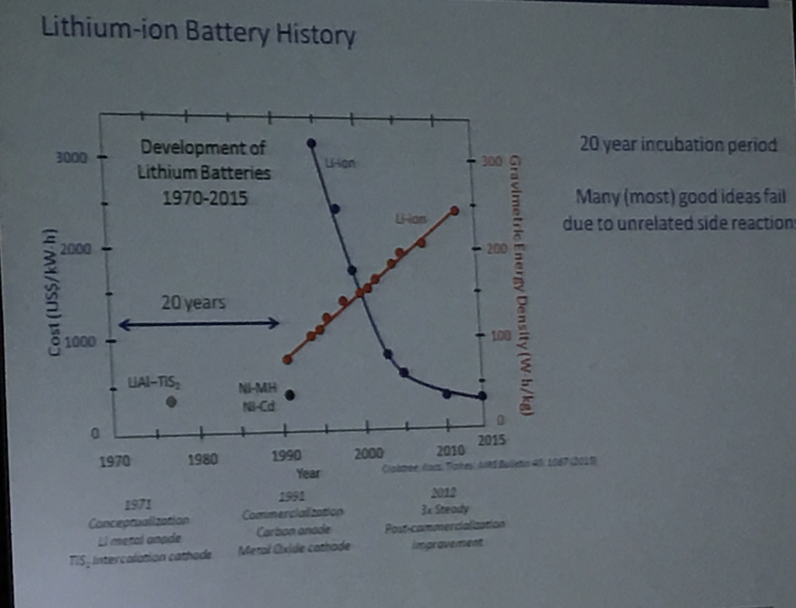

Slide 33
Energy storage cost comparison
Technology | COST, $ / kWh | CYCLE LIFE | COST, $ / kWh / cycle
Lead Acid | $100 | 500 | $0.2
Li-ion | $350 | 1000 | $0.35
High power Li-ion | $1,000 | 5000 | $0.2
Ultracapacitor | $6,000 | 1000000 | $0.006

Slide 34

Beyond lithium for GRIDS
  $100/kWh
  95% roundtrip efficiency @ C/5
  7000 cycles C/5
  20 years calendar life
  Safety as natural gas turbine

Slide 35
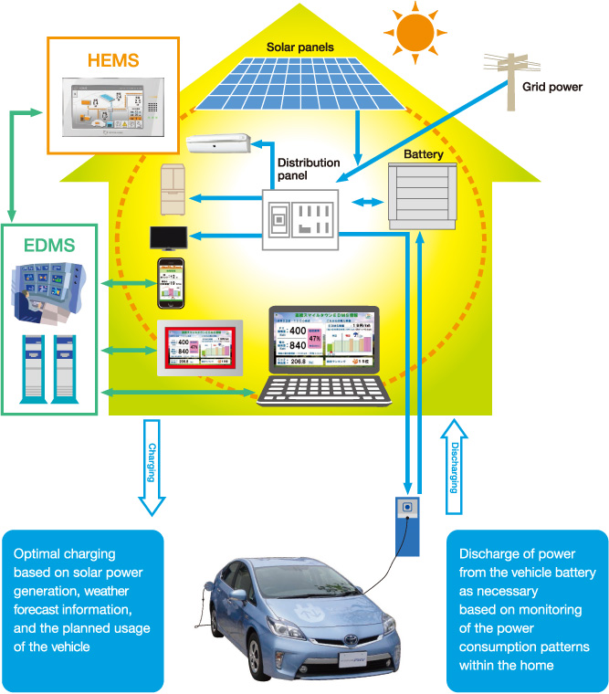
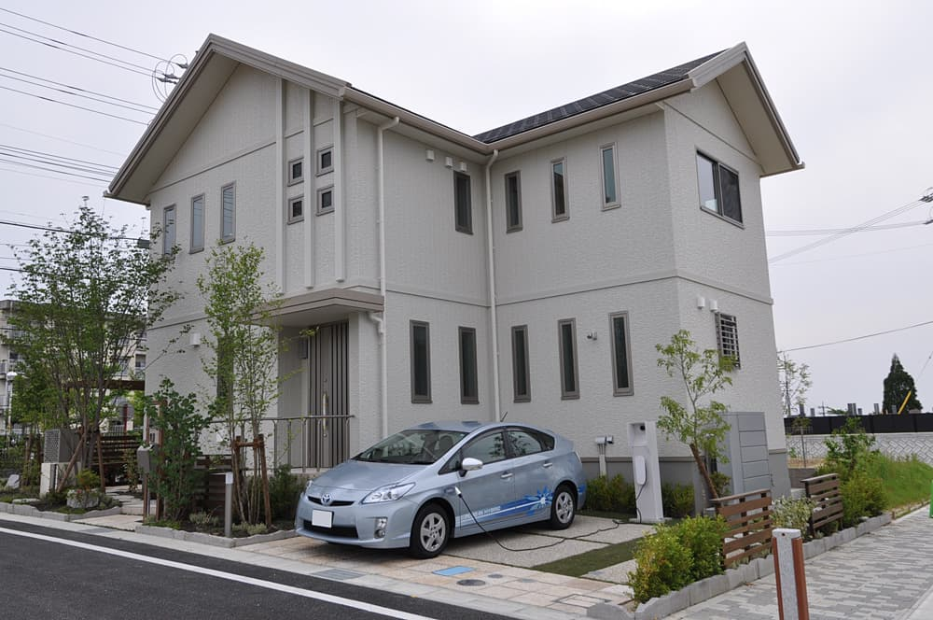
Vehicle-to-home technology

Slide 36
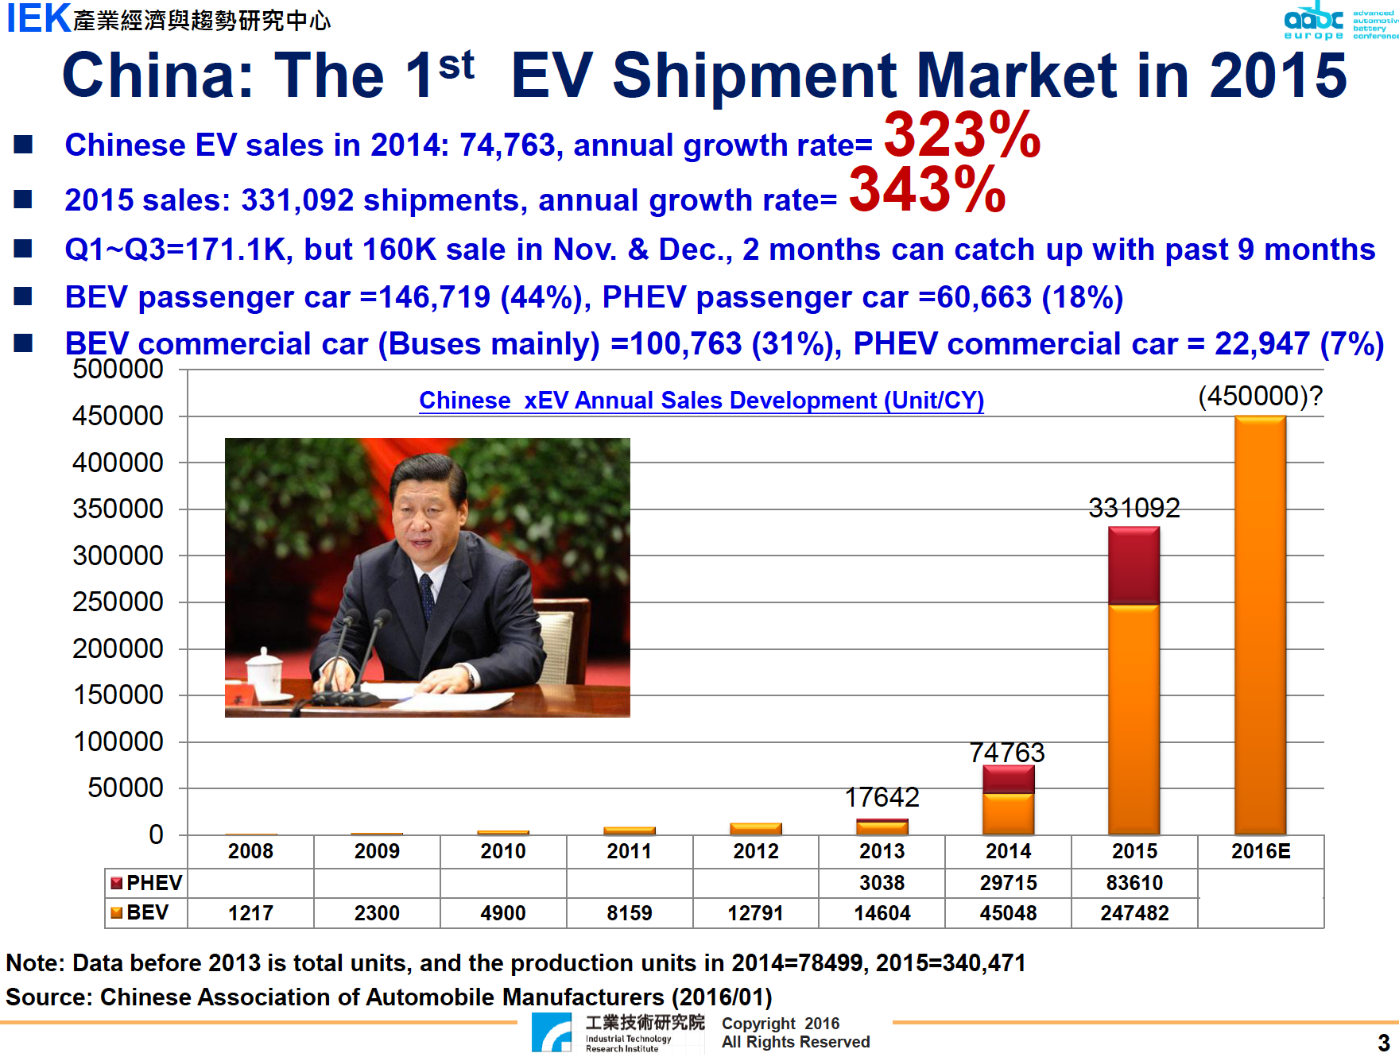

Slide 37
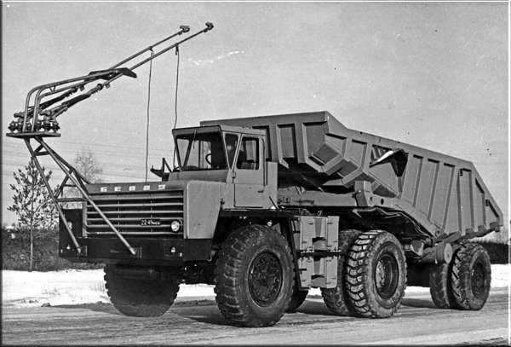
CHARGE CHALLENGE
Чтобы зарядить TESLA S за 15 мин. необходимо около 360 кВт, за 10 мин. - 540 кВт.
Для одновременного заряда 10 автомобилей потребуется мощность около 5,5 МВт. Первая в мире АЭС имела мощность 5 МВт.

Slide 38
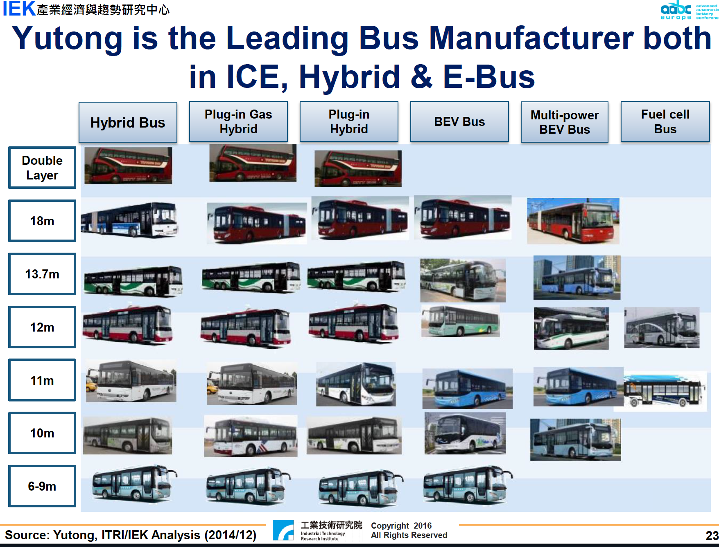

Slide 39
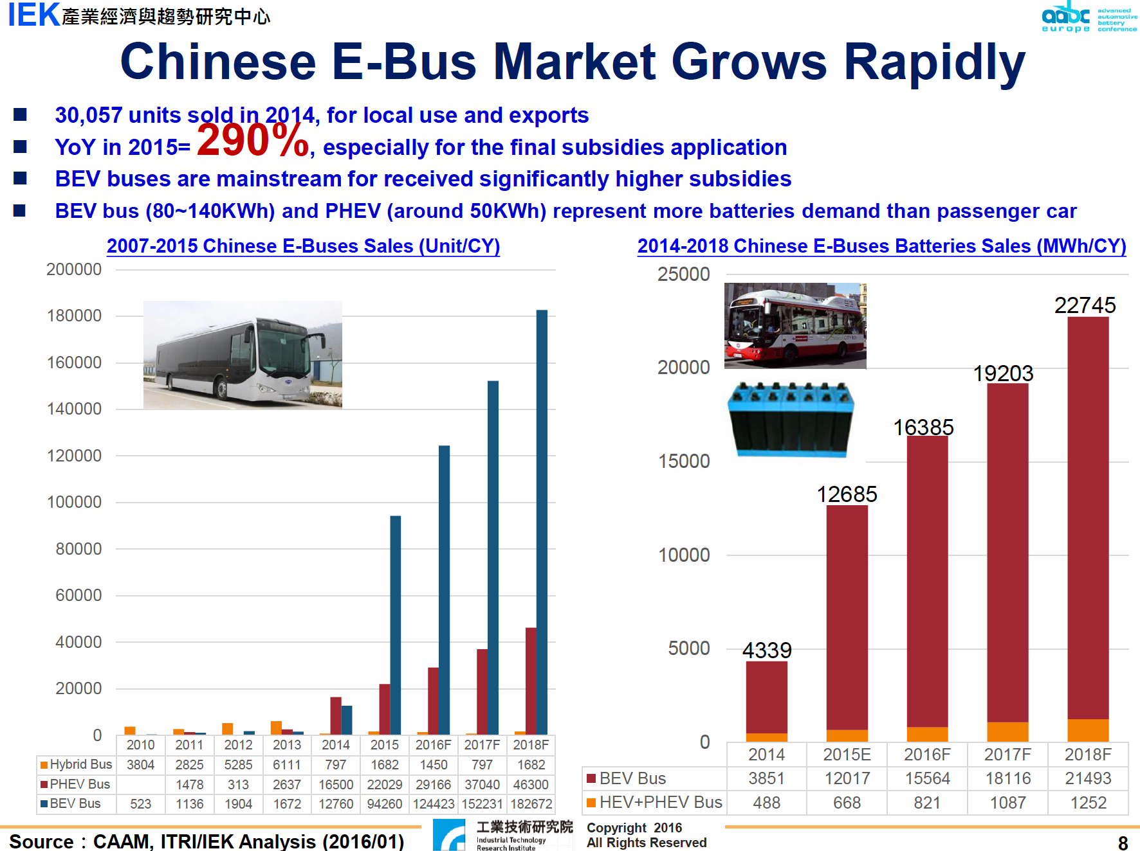

Slide 40
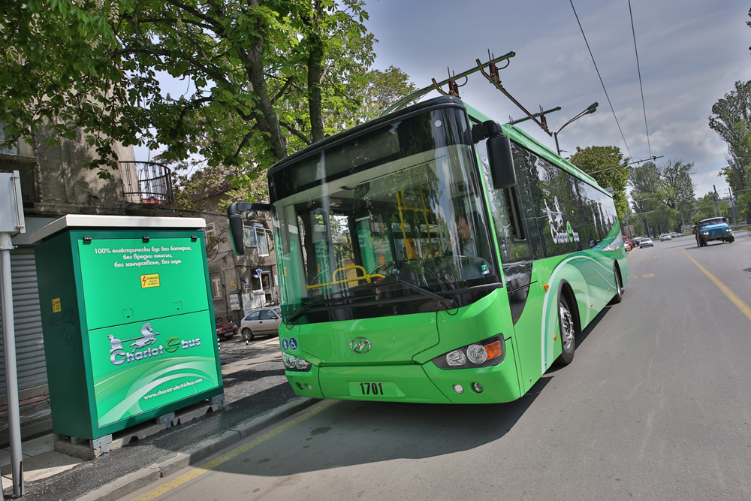

Slide 41
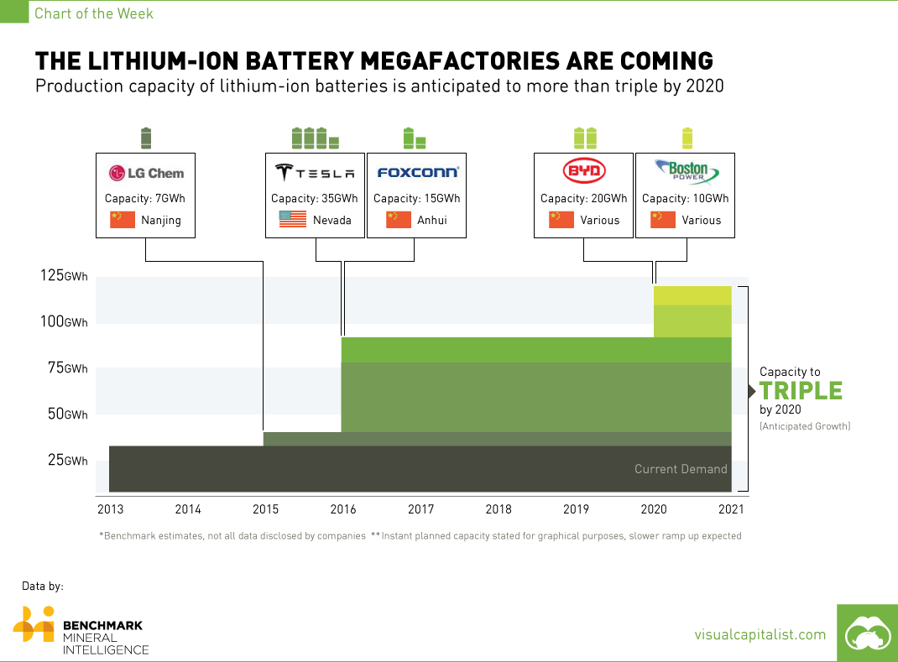

Slide 42


